Slide 1
Chapter 1 Introduction to Web Pages

Slide 2
The Internet
Internet is a large number of computers connected together to share information.
It is a collection of networks (a network of networks) sharing digital information via a common set of networking and software protocols.
It is a network of networks that consists of millions of private, public, academic, business, and government networks, of local to global scope, that are linked together.
Nearly anyone can connect their computer to the Internet and immediately communicate with other computers and users.
The Internet has become an industry in its own respect.

Slide 3
The Internet…
The Internet began in the late 1960s as an experiment in the design of robust computer networks.
The goal was to construct a network of computers that could withstand the loss of several machines without compromising the ability of the remaining ones to communicate.
Funding came from the U.S. Department of Defense, which had a vested interest in building information networks that could withstand nuclear attack.
The result was a network called ARPANET developed by Advanced Research Projects Agency (ARPA) of the United States Department of Defense.
Later ARPANET was replaced by National Science Foundation Network (NSFNET) accessible to research and education organization in 1990s.
NSFNET was finally commercialized in 1995.

Slide 4
The Internet…
The Internet consists of many computers, called servers or hosts, which are linked by communication lines.
These hosts are located in different part of the world.
The administrators of these hosts may make information or software stored on them publically available
So others can view, download or use the data.
Another important thing that has contributed for growth of Internet is ownership.
Until now, nobody owns the Internet.
Its unique design transformed it into a source for innovation that anyone in the world could use.
However, its backbone: servers and Internet Service Providers (ISP) are owned by private as well government organizations.

Slide 5
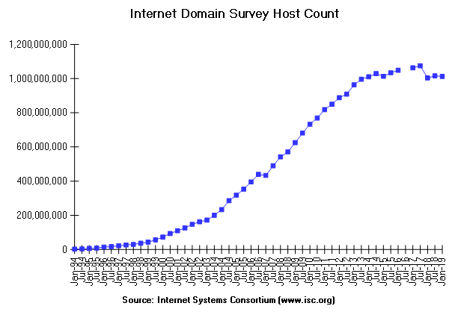
The Internet…
Figure The growth of Internet

Slide 6
The Internet…
The Internet has, in a short space of time, become fundamental to the global economy.
More than a billion people worldwide use it, both at work and in their social lives.
Generally, the services of internet are:
World Wide Web (WWW)
Electronic mail (email)
File Transfer (ftp)
Discussion Groups
Usenet (News Group)
Internet Chat
Search Services

Slide 7
World Wide Web
World Wide Web (WWW) is a collection of interconnected documents and other resources linked by hyperlinks.
Hyperlink is also called hypertext or simply link
Hyperlinks are reference or navigation element in a document to another document.
WWW is a massive storehouse of information that resides on internet.
WWW was created by Tim Berners-Lee in 1989 at the European Nuclear Research Center (CERN) in Switzerland.

Slide 8
World Wide Web...
Berners-Lee created WWW by bringing together three technologies that were already in development at the time:
Markup Language – a system of instructions and formatting codes embedded in text.
Hypertext – a means of embedding links to other documents, images, and other elements in a document.
Internet – a global network of computers where clients request service and servers provide services
WWW pages are connected to one another using hypertext that allows you to move from any page to any other page
The page could be graphics, multimedia files, as well as any Internet resources.

Slide 9
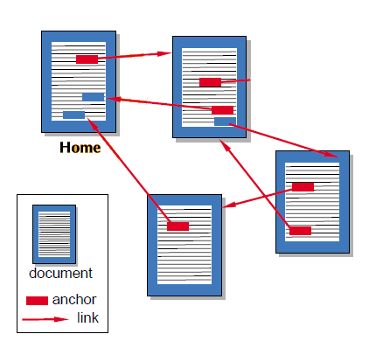
World Wide Web...
Fig WWW pages and how they are interlinked

Slide 10
World Wide Web...
The Web consists of many millions of internet-connected servers with information on them to share.
These documents can be formed of anything from plain text to multimedia or even 3D objects.
The computers on which the information is stored are called servers
Servers deliver this information over the Internet to client computers using a protocol.
The protocol just provides a mechanism that allows a client to request a document, and a server to send that document.

Slide 11
World Wide Web...
The goal of a web server is to serve information to anyone who requests it.
WWW is a client/server architecture where client machines request service from server machines.
In a client/server architecture, some application programs act as information providers (servers), while other application programs act as information receivers (clients).
The backbone of the web is the network of web servers across the world.
These are computers that have a particular type of software running on them: web server
The web server software knows how to speak the protocol and knows which information stored on the computer should be made accessible through the web.

Slide 12
World Wide Web...
The web browser is also particularly clever in the way it displays what it retrieves.
Web pages are written in a certain language called HTML
The browser knows how to display these correctly, whether you have a huge flat screen or a tiny screen on a handheld device or phone.
The language the page has been built with gives the browser hints on how to display things, and the browser decides the final layout itself.

Slide 13
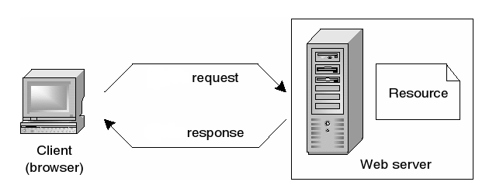
World Wide Web...
Figure 1.2 How WWW works: retrieving a web page from server by clients

Slide 14
HyperText Transfer Protocol(HTTP)
Web clients interact with web servers with a simple application-level protocol called HTTP.
HTTP runs on top of TCP/IP network connections.
HTTP is the standard protocol for transferring web content.
It is the foundation of data communication for the World Wide Web.
HTTP has been in use by the World Wide Web global information initiative since 1990.
The first version of HTTP, referred to as HTTP/0.9, was a simple protocol for raw data transfer across the Internet.

Slide 15
HTTP…
HTTP/1.0 improved the protocol by allowing messages to be in the format of Multipurpose Internet Mail Extension (MIME) like messages, containing meta-information about the data transferred and modifiers on the request/response semantics.
However, HTTP/1.0 does not take in to consideration the need for persistent connections, or virtual hosts.
This has necessitated a protocol version change.
This specification defines the protocol referred to as HTTP/1.1.
This protocol includes more strict requirements than HTTP/1.0 in order to ensure reliable implementation of its features.

Slide 16
HTTP…
The HTTP protocol is a request/response protocol.
A client sends a request to the server in the form of a request method, URI, and protocol version, followed by possible body content over a connection with a server.
HTTP request methods indicate the desired action to be performed on the identified resource.
The most commonly used methods are:
GET - the GET method means retrieve whatever information is identified by the Request-URI.
When a client issues a GET request, it is asking the server for files.
HEAD - The HEAD method is identical to GET except that the server must not return a message-body in the response.
When a client issues a HEAD request it typically is looking to receive the response status code (e.g 200, etc..) only and not the actual body content.

Slide 17
HTTP…
POST - the POST method is used to request that the origin server accept the entity enclosed in the request as a new subordinate of the resource identified by the Request-URI in the Request-Line.
When a client issues a POST request, it is sending data to the server (e.g.. uploading a file, submitting user information, credit card data, etc).
The server responds with a status line, including the message’s protocol version and a success or error code, followed by a MIME like message containing server information, entity meta-information, and possible entity body content.
Most HTTP communication is initiated by a user agent and consists of a request to be applied to a resource on web server

Slide 18
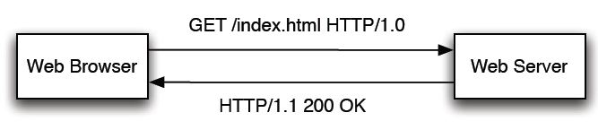
HTTP…
Generally, the HTTP request line includes
Request method, request URL, and HTTP version
The response line include:
HTTP version, status code(a three digit number) and status description which has textual explanation for the status code. It also contains body.

Slide 19
HTTP…
HTTP request line | HTTP response line
HTTP Version (eg. HTTP/1.1, HTTP/1.0) | HTTP Version (eg. HTTP/1.1, HTTP/1.0)
Request method (e.g. GET, POST, DELETE, TRACE, PATCH) | Status code (e.g. 100, 200)
Request URL | Status Description (e.g. Ok and Success (description for status code 100 and 200 respectively)
Table Summary of the structure of HTTP

Slide 20
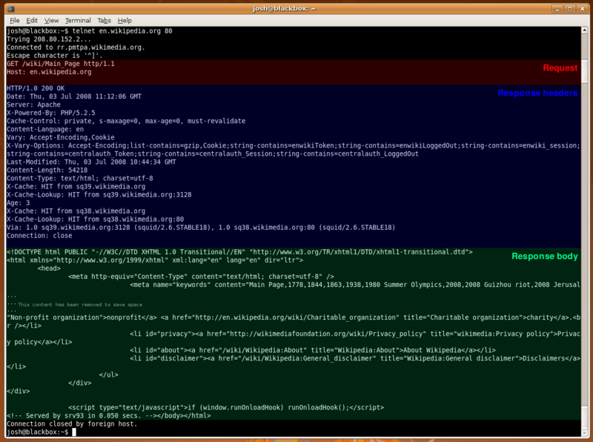

Slide 21
HTTP…
HTTP Status Codes
In HTTP/1.0 and later versions, the first line of the HTTP response is called the status line.
It includes a numeric status code (such as 202) and a textual reason phrase (such as “OK").
The way the user agent handles the response primarily depends on the code and secondarily on the response headers.
The first digit of the status code specifies one of five classes of response: Informational, success, redirection, client error, server error.
It is the bare minimum that an HTTP client should recognizes these five classes.
The phrases used are the standard examples, but any human-readable alternative can be provided.

Slide 22
HTTP…
Informational 1xx
This class of status code indicates a provisional response, consisting only of the Status-Line and optional headers, and is terminated by an empty line.
There are no required headers for this class of status code.
Since HTTP/1.0 did not define any 1xx status codes, servers must not send a 1xx response to an HTTP/1.0 client except under experimental conditions.
A client MUST be prepared to accept one or more 1xx status responses prior to a regular response, even if the client does not expect a 100 (Continue) status message.
Unexpected 1xx status responses may be ignored by a user agent.

Slide 23
HTTP…
Successful 2xx
This class of status code indicates that the client's request was successfully received, understood, and accepted.
Redirection 3xx
This class of status code indicates that further action needs to be taken by the user agent in order to fulfill the request.
The action required may be carried out by the user agent without interaction with the user if and only if the method used in the second request is GET or HEAD.
A client should detect infinite redirection loops, since such loops generate network traffic for each redirection.

Slide 24
HTTP…
Client Error 4xx
The 4xx class of status code is intended for cases in which the client seems to have erred.
Except when responding to a HEAD request, the server should include an entity containing an explanation of the error situation, and whether it is a temporary or permanent condition.
These status codes are applicable to any request method.
User agents should display any included entity to the user.

Slide 25
HTTP…
Server Error 5xx
Response status codes beginning with the digit "5" indicate cases in which the server is aware that it has erred or is incapable of performing the request.
Except when responding to a HEAD request, the server should include an entity containing an explanation of the error situation, and whether it is a temporary or permanent condition.
User agents should display any included entity to the user.
These response codes are applicable to any request method.

Slide 26
HTTP…
Example Status codes:
100 | Continue | The client should continue with its request.
200 | OK | The request has succeeded. The information returned with the response is dependent on the method used in the request.
301 | Moved Permanently | The requested resource has been assigned a new permanent URI and any future references to this resource SHOULD use one of the returned URIs.
404 | Not Found | The server has not found anything matching the Request-URI.
500 | Internal Server Error | The server encountered an unexpected condition which prevented it from fulfilling the request.

Slide 27
1xx: Information
Message: | Description:
100 Continue | Only a part of the request has been received by the server, but as long as it has not been rejected, the client should continue with the request
101 Switching Protocols | The server switches protocol
2xx: Successful
Message: | Description:
200 OK | The request is OK
201 Created | The request is complete, and a new resource is created
202 Accepted | The request is accepted for processing, but the processing is not complete
203 Non-authoritative Information
204 No Content
205 Reset Content
206 Partial Content

Slide 28
HTTP…
3xx: Redirection
Message | Description
300 Multiple Choices | A link list. The user can select a link and go to that location. Maximum five addresses
301 Moved Permanently | The requested page has moved to a new url
302 Found | The requested page has moved temporarily to a new url
303 See Other | The requested page can be found under a different url
304 Not Modified
305 Use Proxy
306 Unused | This code was used in a previous version. It is no longer used, but the code is reserved
307 Temporary Redirect | The requested page has moved temporarily to a new url

Slide 29
4xx: Client Error
Message | Description
400 Bad Request | The server did not understand the request
401 Unauthorized | The requested page needs a username and a password
402 Payment Required | You can not use this code yet
403 Forbidden | Access is forbidden to the requested page
404 Not Found | The server can not find the requested page
405 Method Not Allowed | The method specified in the request is not allowed
406 Not Acceptable | The server can only generate a response that is not accepted by the client
407 Proxy Authentication Required | You must authenticate with a proxy server before this request can be served
408 Request Timeout | The request took longer than the server was prepared to wait
409 Conflict | The request could not be completed because of a conflict
410 Gone | The requested page is no longer available
411 Length Required | The "Content-Length" is not defined. The server will not accept the request without it
412 Precondition Failed | The precondition given in the request evaluated to false by the server
413 Request Entity Too Large | The server will not accept the request, because the request entity is too large
414 Request-url Too Long | The server will not accept the request, because the url is too long. Occurs when you convert a "post" request to a "get" request with a long query information
415 Unsupported Media Type | The server will not accept the request, because the media type is not supported
416
417 Expectation Failed

Slide 30
HTTP…
5xx: Server Error
Message: | Description:
500 Internal Server Error | The request was not completed. The server met an unexpected condition
501 Not Implemented | The request was not completed. The server did not support the functionality required
502 Bad Gateway | The request was not completed. The server received an invalid response from the upstream server
503 Service Unavailable | The request was not completed. The server is temporarily overloading or down
504 Gateway Timeout | The gateway has timed out
505 HTTP Version Not Supported | The server does not support the "http protocol" version

Slide 31
Web Technologies
Originally, the internet was designed to serve “static” pages.
Over time, many technologies were introduced to introduce dynamicity into web pages.
Fig Web technologies

Slide 32
Web Technologies…
I. Perl Technology
Perl originated as system administrator Language.
It grew quickly in its feature set especially text parsing.
It is one of the first Web languages.
It is popularly synonymous with CGI (Common Gateway Interface).
Perl is an open-source language optimized for writing server-side applications.
Together, CGI and Perl make it easy to connect to a variety of databases.

Slide 33
Web Technologies…
In terms of security, Perl has a special mode called taintmode.
Taintmode puts Perl in a sort of paranoid secure watchdog mode in which user input are not trusted and used directly.
CGI is slow though (but may be fast enough for many website needs).
Perl is not multi-threaded.
II. Java Technology (Java/J2EE)
Java provides two web technologies: JSP (Java Server Pages) and Servlets.
Servlets – A technology allowing Java to run inside a web server dynamically
JSPs – A technology to allow Java to be embedded in HTML pages

Slide 34
Web Technologies…
The pros of Java Servlet technology include:
The applications are cached on the web server and may run many times (unlike CGI)
The data for the application may also be cached (e.g. database connection pooling)
Intermediate Compiled language
It is cross Platform
It has built-In multithreading
JSPs are compiled into Servlets so share the same benefits.

Slide 35
Web Technologies…
III. PHP Technology
PHP is designed for the Web.
This makes PHP very different from Java and Perl.
Essentially PHP is a powerful template language.
PHP is designed as a scripting language.
Hence, like Perl, this makes it easy to change a page and test changes immediately.
PHP is designed to be easy.
One of the advantages of PHP is that the language is simple.
Most of what you want to do with the web is basically built-in in PHP.
It has all the required libraries for web programming.
PHP is very easy to set up for an ISP in web servers.

Slide 36
Web Technologies…
First, the database access commands as taught to new programmers are very easy to access a specific database.
However, it is annoying to switch database.
The code is database specific and changing to another database requires changing the PHP data access code.
This is in contrast with Perl DBI or Java JDBC which are database independent as much as possible.
mysql_ mysql database connections
pg_ postgre database connections

Slide 37
URI, URL, and URN
URI stands for Uniform Resource Identifier, which is used to identify resource on the web.
A URI identifies a resource either by location, or a name, or both.
More often than not, most of us use URIs that defines a location to a resource.
URIs can be classified as Uniform Resource Locators (URLs), as Uniform Resource names (URNs), or as both.
A uniform resource name (URN) functions like a person's name, while a uniform resource locator (URL) resembles that person's street address.
In other words, the URN defines an item's identity, while the URL provides a method to find it.

Slide 38
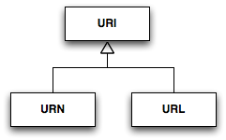
URI, URL, and URN…
Fig Uniform Resource Identifier

Slide 39
URI, URL, and URN…
The World Wide Web can be conceived as a large group of resources placed in different computers all around the world.
These resources can be found and linked through URIs.
URI identifies resources by assigning them addresses in a given network.
A URL is a type of URI that's used to describe the location of a specific document.
A URL doesn't define the type of content to be found (texts, images, movies, etc.), it only shows where to find it.

Slide 40
URI, URL, and URN…
A common URL is composed by four parts:
The protocol: this specifies which protocol is used to access the document. It is also called URL scheme.
The computer name: gives the name of the computer, usually a domain name or IP address, where the content is hosted.
The directories path: Sequence of directories that define the path to follow to reach the document.
The file name: The name of the file containing the resource.
For example, http://www.htmlquick.com/reference/tags/span.html
Protocol: http://
Computer name (domain name): www.htmlquick.com
Directories path: /reference/tags/
File name: span.html

Slide 41
URI, URL, and URN…
Other examples of URL are:
http://www.wikipedia.org
mailto:John.Doe@example.com
ftp://ftp.is.co.za/rfc/rfc1808.txt
tel:+1-816-555-1212
telnet://melvyl.ucop.edu/
file:///home/username/books/
A URN identifies a resource by name in a given namespace but not define how the resource maybe obtained.
URN functions like a person's name, while a URL resembles that person's street address.
In other words, the URN defines an item's identity, while the URL provides a method for finding it.

Slide 42
URI, URL, and URN…
The ISBN system for uniquely identifying books provides a typical example of the use of URNs.
ISBN 0-486-27557-4 (urn:isbn:0-486-27557-4) cites, unambiguously, a specific edition of Shakespeare's play Romeo and Juliet.
To gain access to this object and read the book, one needs its location: a URL address.
A typical URL for this book on a Unix-like operating system would be a file path such as file:///home/username/books/, identifying the electronic book library saved on a local hard disk.
So URNs and URLs have complementary purposes.

Slide 43
URI, URL, and URN…
Example URN are:
urn:isbn:0451450523 - The URN for The Last Unicorn (1968 book), identified by its book number.
urn:isan:0000-0000-9E59-0000-O-0000-0000-2 - The URN for Spider-Man (2002 film) identified by its audiovisual number.
urn:issn:0167-6423 - The URN for the Science of Computer Programming (scientific journal), identified by its serial number.
urn:ietf:rfc:2648 - The URN for the IETF's RFC 2648.

Slide 44
Web Page Address
Internet addressing is a systematic way to identify people, computer and the Internet resources.
Address can mean many different things from an electronic mail address to a URL.
When a new site is put online it has a specific network address that looks something like 207.70.128.240.
In order to make the site easier to remember, a unique name is correlated with the number.
IP Address - An IP address is a unique number that identifies computer on the Internet; every computer directly connected to the Internet has one.

Slide 45
Web Page Address…
Domain Name - Most computers on the Internet have a domain name.
A domain name is the text name corresponding to the numeric IP address of a computer on the Internet.
A domain name must be unique.
Internet users access your website using your domain name.
A domain name always contains two or more components separated by periods, called “dots”.
Some examples of domain names are: ibm.com, nasa.gov, aau.edu.et, telecom.net.et, etc.
Once a domain name has been established, “sub-domains” can be created within the domain.
For example, the domain name for a large company could be “vni.com” and within this domain, sub-domains can be created for each of the company’s regional offices.

Slide 46
Web Page Address…
The portion of a domain name after the dot describes the type of organization holding that name.
The major categories are:
com: commercial entities
edu: educational institutions
net: organizations directly involved in the Internet operations, such as network providers and network information centers.
org: miscellaneous organizations that do not fit any other category, such as non-profit groups
gov: united states federal government entities
mil: united states military
Country codes: a two-letter abbreviation for a particular country for example et for Ethiopia, uk for united kingdom, or fr for France.

Slide 47
Web Page Address…
For example: http://piglet.exeter.ac.uk/pallas/index.html, the parts of the URL could be decomposed as follows.
The parts of a URL
http: the method of “delivery” (ftp, file, etc.). The :// is important to distinguish this from the server name that follows
piglet.ex.ac.uk: the server computer the document is stored on. This could also be referred to by its IP number, e.g. 144.173.116.100.
Breaking this down further:
piglet the host: the name of the individual computer/ server. These are usually decided upon by the organization concerned.
exeter: the “organisation” :exeter or ex (domain name = exeter.ac.uk)
ac: the “organisation type”: ac or edu for academic sites,
uk: the “country code” – uk, fr, et, etc.
pallas: the directory/folder
index.html: the file itself

Slide 48
Domain Name Registration
A domain name is a unique name for a web site, like http://www.w3schools.com.
Domain names must be registered to be used for websites.
When domain names are registered, they are added to a large domain name register.
In addition, information about the web site, including the IP address, is stored on a DNS server.
Getting a domain name involves registering the name you want with an organization called ICANN (Internet Corporation for Assigned Names and Numbers) through a domain name registrar.
For example, if you choose a name like "example.com", you will have to go to a registrar, pay a registration fee and get registered.
That will give you the right to the name for a year, and you will have to renew it annually.

Slide 49
Domain Name Registration...
Domain registration information is maintained by the domain name registries, which contract with domain registrars to provide registration services to the public.
An end user selects a registrar to provide the registration service, and that registrar becomes the designated registrar for the domain chosen by the user.
Only the designated registrar may modify or delete information about domain names in a central registry database.

Slide 50
Domain Name Registration...
A domain name registrar is an organization that manages the reservation of Internet domain names.
There are numerous domain name registrars.
Some of the popular ones are:
www.godaddy.com — This is a very popular registrar and possibly the biggest today offers .com domain names for $9.99.
www.dotster.com — This fairly popular registrar provides fairly cheap domain prices ($15.75 plus 20 cents per domain).
www.register.com — This domain name registrar has been in business for a very long time.

Slide 51
Web Hosting
To make your Web site visible to the world, it has to be hosted on a Web server.
Hosting your web site on your own server is always an option.
Here are some points to consider:
Hardware Expenses
To run a real web site, you will have to buy some powerful server hardware.
Don't expect that a low cost PC will do the job.
You will also need a permanent (24 hours a day ) high-speed connection.
Software Expenses
Remember that server-licenses often are higher than client-licenses.
Also note that server-licenses might have limits on number of users.

Slide 52
Web Hosting...
Labor Expenses
Don't expect low labor expenses.
You have to install your own hardware and software.
You also have to deal with bugs and viruses, and keep your server constantly running in an environment where everything could happen.
To let others view your web pages, you must publish your web site.
To publish your work, you must copy your site to a web server.
Your own PC can act as a web server if it is connected to a network.
The most common approach is to use web hosting providers.
Web hosting means storing your web site on a public web server.

Slide 53
Web Hosting...
Some of the web hosting providers are:
http://www.justhost.com/
http://www.ipage.com/
http://www.fatcow.com/
http://www.webhostinghub.com/
Things to Consider with selecting web hosting providers:
24-hour support
Make sure your ISP offers 24-hours support.
Don't put yourself in a situation where you cannot fix critical problems without having to wait until the next working day.
Toll-free phone could be vital if you don't want to pay for long distance calls.

Slide 54
Web Hosting...
Daily Backup
Make sure your ISP runs a daily backup routine, otherwise you may lose some valuable data.
Traffic Volume
Study the ISP's traffic volume restrictions.
Make sure that you don't have to pay a fortune for unexpected high traffic if your web site becomes popular.
Bandwidth or Content Restrictions
Study the ISP's bandwidth and content restrictions.
If you plan to publish pictures or broadcast video or sound, make sure that you can.

Slide 55
Web Hosting...
E-mail Capabilities
Make sure your ISP supports the e-mail capabilities you need.
Database Access
If you plan to use data from databases on your web site, make sure your ISP supports the database access you need.

Slide 56
Domain Name System (DNS)
DNS refers to Domain Name System.
DNS converts domain names to IP addresses.
Its special mission is to be a mediator between the IP addresses which is the system-side names of the websites, and their user-side alpha-numeric names.
While it's easy to remember the name of a website, it's quite hard to remember the exact IP address.
For example, we can easily remember http://www.google.com , but not "74.125.45.100”.
DNS solves this problem.
Every time a domain name is typed in a browser it is automatically passed on to a DNS server, which translates the name into its corresponding IP address.

Slide 57
Domain Name System (DNS)…
DNS began in the early days when the Internet was only a small network created by the Department of Defense for research purposes.
Host names of computers were manually entered into a file (called HOSTS.TXT) which was located on a central server.
Each site/computer that needed to resolve host names had to download this file.
Until the mid-1980s, this approach was to convert domain names to IP addresses.
As the numbers of Internet users started to grow faster and faster, this system reached its limits fast.
To solve this, in 1984 the Domain Name System was introduced.

Slide 58
Domain Name System (DNS)…
Hierarchy of Domain Names
At the top of the DNS hierarchy are 13 root name servers, which contain name server information for all of the generic top-level domains.
Top level domains are .com and .org as well as country-specific DNS addresses such as .uk or .nz.
The name servers for each of these top-level domains contains name server information for domains within that top-level domain.
So the name server for .com will contain information about microsoft.com but will not contain information about microsoft.co.uk.
Your name server will have to contact the server that contains the information for .co.uk.

Slide 59
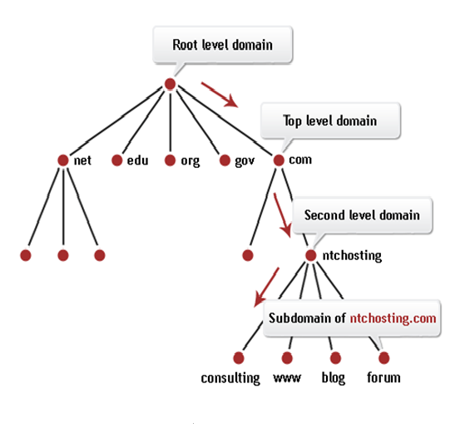
Domain Name System (DNS)…

Slide 60
Domain Name System (DNS)…
All DNS records actually end with the period character (.)
Period (.) represents the root of the DNS hierarchy, but it's rarely printed and is usually just assumed.
For example, if you take the domain name www.microsoft.com, here is how it is organized
www.microsoft.com.
. | Root domain
com | The com top-level domain
microsoft | The domain microsoft within .com
www | The host www within the domain microsoft.com

Slide 61
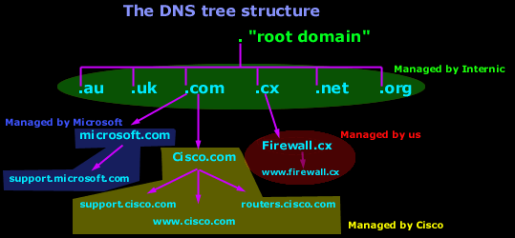
Domain Name System (DNS)…

Slide 62
Domain Name System (DNS)…
ICANN controls the “root domain”, which includes all the top level domains.
The Root DNS servers know all about the authoritative DNS servers for the domains immediately below them. e.g. firewall.cx, cisco.com, microsoft.com etc.
These Root DNS servers can tell you which DNS server takes care of firewall.cx, cisco.com, microsoft.com and the rest.
To visit the Cisco website, we go to web browser and type http://www.cisco.com and after a few seconds, the website is displayed.
But what happens in the background after they type the address and hit enter is pretty much unknown to most users.

Slide 63
Domain Name System (DNS)…
Common top level domains:
.edu
.biz
.gov
.cat
.mil
.int
.info
Common country codes:
.uk
.us
.eu
.et
.de

Slide 64
Domain Name System (DNS)…
Here is what happens:
1. You open your web browser and enter www.cisco.com in the address field.
At that point, the computer doesn't know the IP address for www.cisco.com, so it sends a DNS query to your ISP's DNS server.
2. Your ISP's DNS server doesn't know the IP for www.cisco.com, so it will ask one of the ROOT DNS servers.
3. The ROOT DNS server checks its database and finds that the Primary DNS for Cisco.com is 198.133.219.25.
It replies to your ISP's server with that answer.
4. Your ISP's DNS server now knows where to contact Cisco's DNS server and find out if www.cisco.com exists and its IP.
Your ISP's DNS server sends a recursive query to Cisco.com's DNS server and asks for an IP address for www.cisco.com.

Slide 65
Domain Name System (DNS)…
5. Cisco's DNS server checks its database and finds an entry for "www.cisco.com".
This entry has an IP address of 198.133.219.25. In other words, the webserver is running on the same physical server as the DNS ! If it wasn't running on the same server, then it would have a different IP.
6. Your ISP's DNS server now knows the IP address for www.cisco.com and sends the result to your computer.
7. Your computer now knows who it needs to contact to get to the website.
So it sends an http request directly to Cisco's webserver and downloads the webpage.

Slide 66
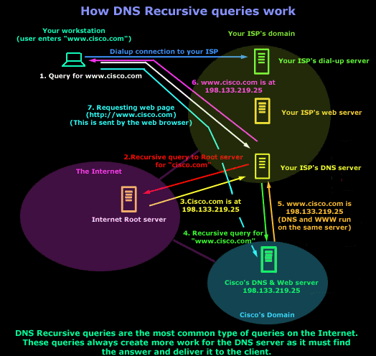

Slide 67
HTML
HTML is a standard language.
The standard is decided upon by a large body of volunteers and experts, who oversee its progress and guide its development.
This body is managed by the World Wide Web Consortium (W3C, http://www.w3.org/)
Currently recommends the use of HTML 4.01, its latest standard.

Slide 68
HTML…
The next generation of HTML is called XHTML
XHTML is defined in a cut down version of SGML called XML (eXtensible Markup Language).
XHTML is stricter in its definition of tags (has strict syntax rules), but it is much more flexible, in that it is much easier for computers to interpret.
When a computer reads any kind of document, it must follow a strict pattern or syntax, and the stricter this is, the easier the computer finds the interpretation, even though we as humans may find it difficult to write so accurately.
Tools such as Dreamweaver and dedicated XML editors make writing this stricter form of HTML much easier.

Slide 69
HTML…
History of HTML
The original HTML draft - Tim Berners-Lee based his original markup language for hypertext documents on the syntax and elements in SGML, but added the anchor <a> element for adding hypertext links.
HTML + - This version of HTML, written by Dave Raggett in 1993 and 1994, builds upon Berners-Lee’s original version, adding elements such as figures, tables, and forms.
Many of the ideas developed here made it into later versions, but the specific elements (such as fig for figures) were left behind.
HTML 2.0 - This was a proposed standard developed by Tim Berners-Lee and the HTML Working Group at IETF.
It was developed by the Internet Engineering Task Force HTML Working Group in 1995.
At this point, the Web was still in its infancy.

Slide 70
HTML…
HTML 3.2
The HTML 3.0 draft was introduced to standardize HTML.
This draft included several new abilities and more powerful opportunities for webpage developers.
But many browsers could not implement them.
For this reason, the HTML 3.0 draft was abandoned.
HTML 3.2 is the first recommendation released by the newly-formed W3C in 1996.
It is a snapshot of all the HTML elements in common use at the time and includes many extensions to HTML that were the result of the notorious Browser War between Netscape and Microsoft.
Many of these extensions are presentational, and in hindsight, most would say they should have never been incorporated in the standard.

Slide 71
HTML…
HTML 4.0 and 4.01
HTML 4.0, released as a Recommendation in 1998.
It HTML back on track by acknowledging that all matters of presentation should be handled with CSS and remain separate from document markup.
Many of the presentational elements and attributes introduced in HTML 3.2 were kept because they were in widespread use, however, they were labeled as deprecated.
HTML 4.0 also introduced a number of accessibility and internationalization features.
The updated HTML 4.01 Recommendation fixed some small issues and was released in 1999.
It also served as the basis for the XHTML 1.0 Recommendation.

Slide 72
HTML…
HTML 5
In 2008, W3C published a working draft for HTML 5.
HTML 5 improves interoperability, and reduces development costs, by making precise rules on how to handle all HTML elements, and how to recover from errors.
Some of the new features in HTML 5 are functions for embedding audio, video, graphics, client-side data storage, and interactive documents.
HTML 5 also contains new elements like <nav>, <header>, <footer>, and <figure>.

